Slide 1
Expenses and Smoking Habit
Date | Expenses cig | Tea | Petrol | Other Expenses | Item | Craving Trigger
1 | 10 | 0 | 0 | 0
2 | 0 | 0 | 0 | 0
3 | 360 | 16 | 0 | 395 | Jio Recharge
4 | 120 | 30 | 0 | 471 | Broadband
5 | 130 | 120 | 0 | 0
6 | 55 | 50 | 0 | 0
7 | 61 | 0 | 0 | 0
8 | 78 | 0 | 0 | 0
9 | 250 | 0 | 0 | 0
10 | 210 | 0 | 0 | 0
11 | 50 | 0 | 0 | 0
12 | 10 | 20 | 105 | 0
13 | 120 | 0 | 0 | 0
14 | 114 | 0 | 103 | 449 | Netflix
15 | 31 | 0 | 0 | 0 |  | 38
16 | 70 | 0 | 100 | 0 |  | 20
17 | 70 | 0 | 0 | 0 |  | 10
18 | 240 | 0 | 170 | 0 |  | 10
19 | 180 | 0 | 107 | 0 |  | 10
20 | 47 | 0 | 0 | 0 |  | 10
21 | 150 | 0 | 110 | 0
22 | 60 | 0 | 0 | 0
23 | 270 | 40 | 0 | 1200 | Mirror car
24 | 80 | 60 | 210 | 0
25 | 80 | 40 | 0 | 0 |  | 50
26 | 140 | 80 | 0 | 0
27 | 50 | 0 | 100 | 0
28 | 70 | 0 | 0 | 0
29 | 80 | 0 | 220 | 0
30 | 28 | 0 | 0 | 0
31 | 20 | 12 | 0 | 0
Total | 3234 | 468 | 1225 | 2515 |  | 148

Slide 2
CHART OF MONTHLY EXPENCES
January | 1500
February | 5777
March | 6242
April
May
June
July
August
September
October
November
December
Total | 13519

Slide 3
Smoking Count
day | Brand | Count
1 | Kings | 2
2 | Kings | 1
3 | Kings | 1
4 | Kings | 4
5 | Kings | 1
6 | Kings | 3
7 | Kings | 8
8 | Kings | 6
9 | Kings | 6
10 | Kings | 0
11 | Kings | 2
12 | Kings | 3
13 | Kings | 2
14 | Gold Flake | 2
15 | Kings | 2
16 | Kings | 4
17 | Kings | 5
18 | Kings | 3
19 | Kings | 2
20 | Kings | 3
21 | Kings | 2
22 | Kings | 2
23 | Lites | 1
24 | Players | 2
25 | Lites | 4
26 | Gold Flake | 2
27 | DavidOff | 2
28 | Kings | 2
29 | Gold Flake | 1
30 | Kings | 4
31 | wills | 1
Total |  | 83

Slide 4
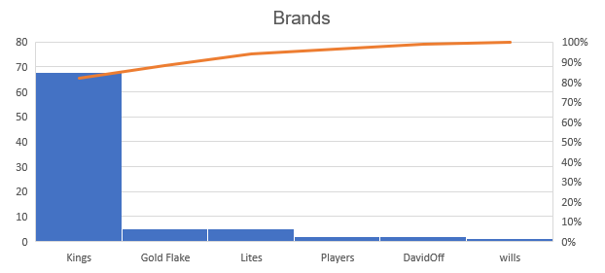
Brand and Count
Brand | Brand Count
Kings | 68
Lites | 5
Gold Flake | 5
Wills | 1
Davidoff | 2
Players | 2

Slide 5
Benefits of The analysis
Through this analysis I found the data about my expenses
I found how much I smoke per day
What are other expenses petrol and many more
Learned to create chart
Different functions of Excel

